Slide 1

Gradient Boosting (XGBOOST)
Tree

Slide 2
Introduction to Gradient Boosting
Gradient Boosted Tress, which is one of the most commonly used “Boosting” algorithm. This is a type of Supervised Learning algorithm.
There are different boosting algorithm exists. Here, we will only consider Gradient Boosting algorithm.
Boosting is collection of weak learners combined to form a stronger learner.
Gradient Boosting can be applied for both “Regression and Classification”

Slide 3
Introduction to Gradient Boosting
Gradient Boosting is a type of Ensemble Learning.
Ensemble Learning is the process by which multiple models, such as classifiers, experts, are generated and combined to solve a particular problem.
Ensemble Learning is primarily used to improve the classification, prediction, function approximation and so on.

Slide 4
Introduction to Gradient Boosting
Gradient Boosting algorithm can be classified into two key features:
  Multiple Iterations
  Each subsequent iteration focus on the parts of the problem that previous iteration got wrong.

Slide 5
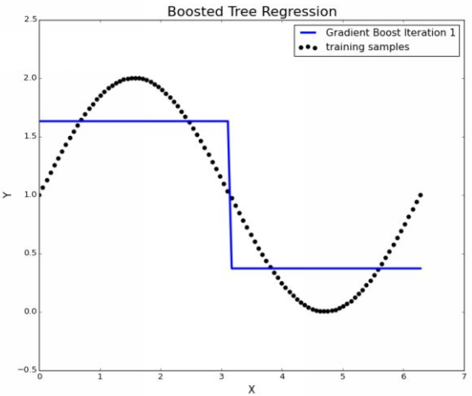
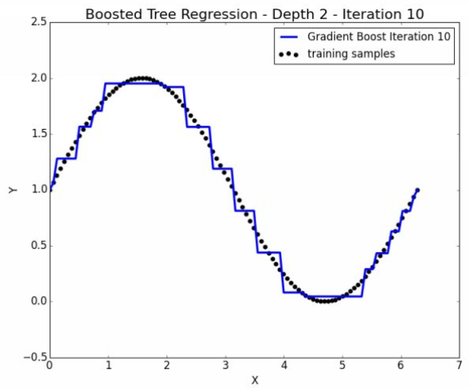
Introduction to Gradient Boosting

Slide 6
Introduction to Gradient Boosting
Let’s understand the algorithm by taking very simple example.
Suppose you are Data Science teacher and teaching a class of 20 students from different educational background.
On the day 1, you knows nothing about the quality of those 20 students so you starts with standard/basic class (like basic stats)
On day 2 or subsequent days, you have some background of how well each students are doing. So, you will focus more only on those students who are very weak in Data Science or worst students. Here, your goal is to make the best students perfect but you will bring weak students to average.
So as a good teacher, you will first concentrate on weak students and will try to make them average.

Slide 7
Introduction to Gradient Boosting
Now let’s relate this example to Boosting.
Simple, the iterations take place at each subsequent day at each new class.
On each subsequent days, you will find weak students (errors) and will improve them.
Another way to interpret is, a group of daily instructions (the weak learners) can be combined to produce a good quality course (the strong learner)

Slide 8
Weak Learner
A weak learner is any machine learning algorithm that give better accuracy than simply guessing.
For instance, you are trying to classify the animals at zoo and you might have algorithm that can correctly classify the zebras most of the time but it simply guesses for any other animals.
This algorithm would be a weak learner because it is better than guessing.
For boosting problem, the best kind of weak learners are the ones that are very accurate, even if it is only over a limited scope of problem.
Here, we have an algorithm which will at least identify the zebras. So we will concentrate only on remaining animals.

Slide 9
Regression Decision Tree
Boosting algorithm uses decision tree regressor as their base. It will split the data which will form series of IF-THEN conditions.
For a numeric response variable, these splits/partitions are done by minimizing the sum of square error.
Each value of predictor variables can be potential splits and each split attempts to minimize the sum of squared error.
It starts with mean of the variable and then calculate the error. If the error is there, it will start splitting into different groups.

Slide 10
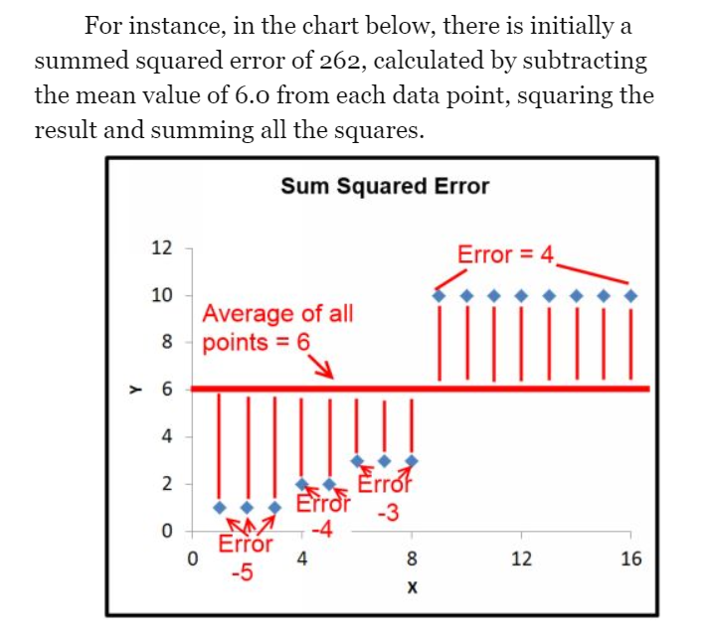
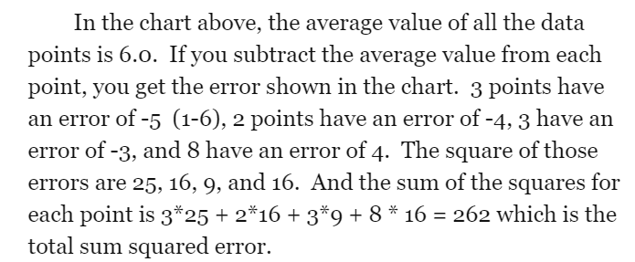
Regression Decision Tree

Slide 11
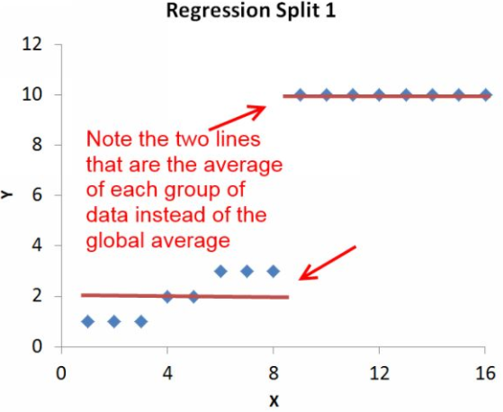
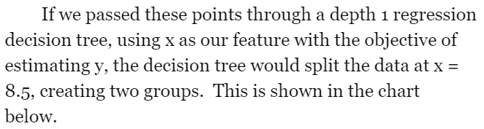
Regression Decision Tree

Slide 12
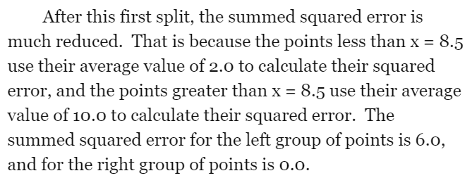
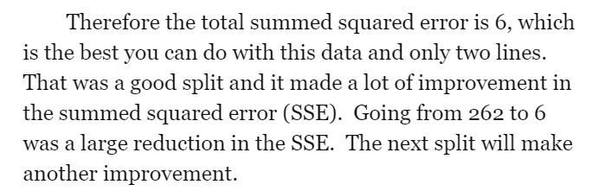
Regression Decision Tree

Slide 13
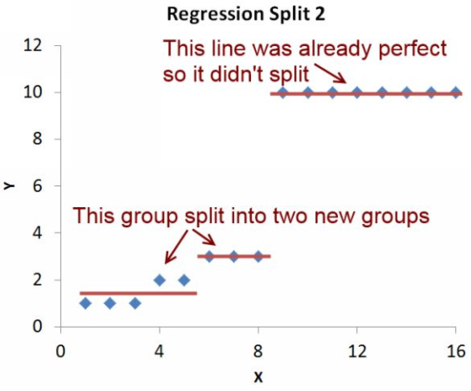
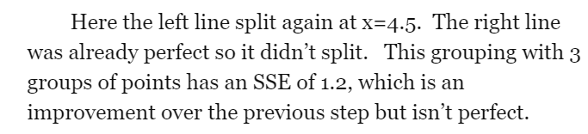
Regression Decision Tree

Slide 14
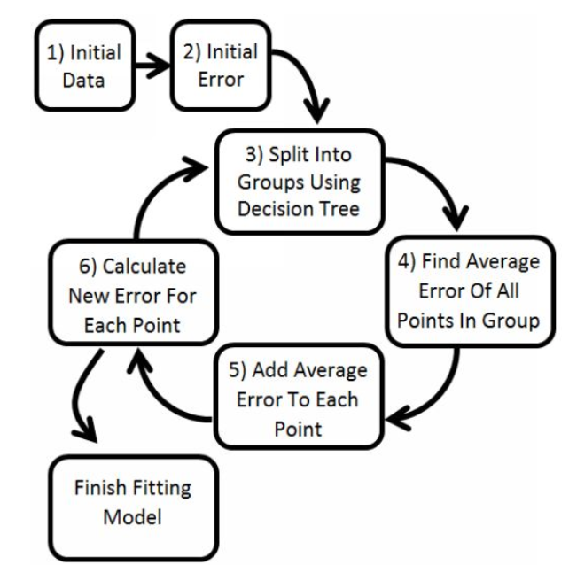
Gradient Boosted Trees

Slide 15
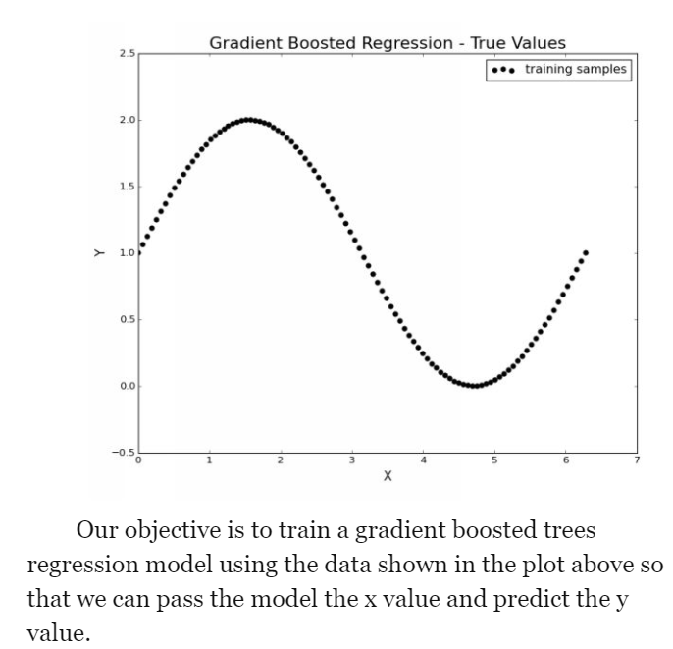
Gradient Boosted Trees

Slide 16
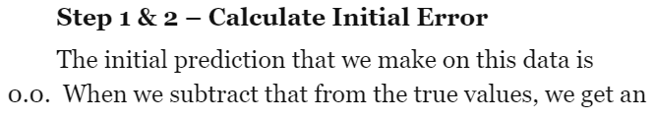
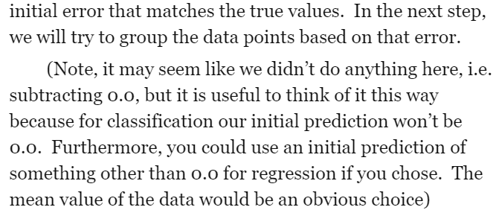
Gradient Boosted Trees

Slide 17
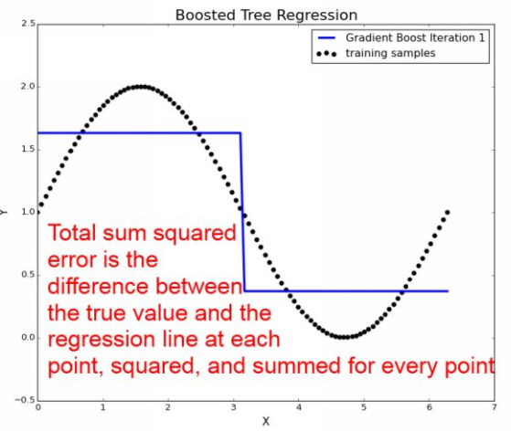
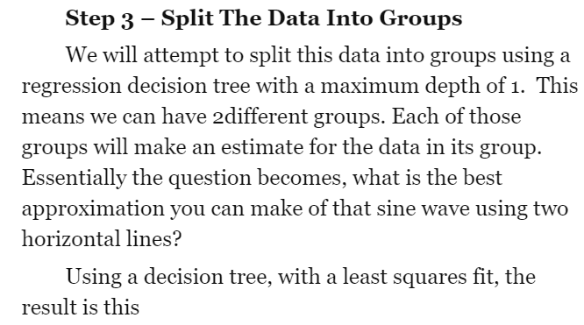
Gradient Boosted Trees

Slide 18
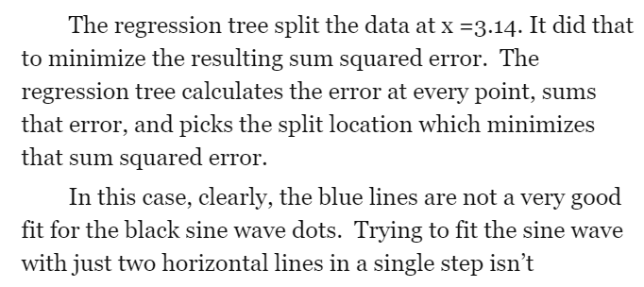
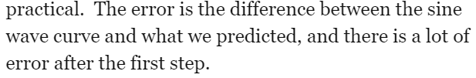
Gradient Boosted Trees

Slide 19
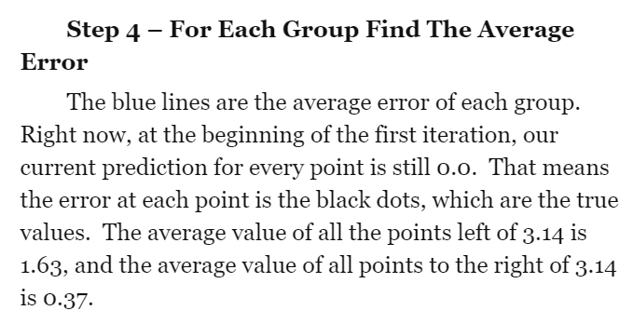
Gradient Boosted Trees

Slide 20
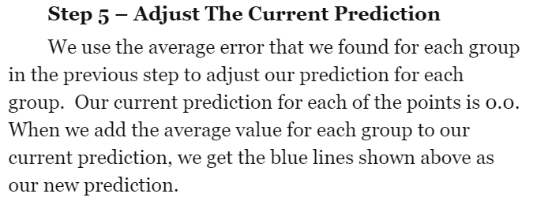
Gradient Boosted Trees

Slide 21
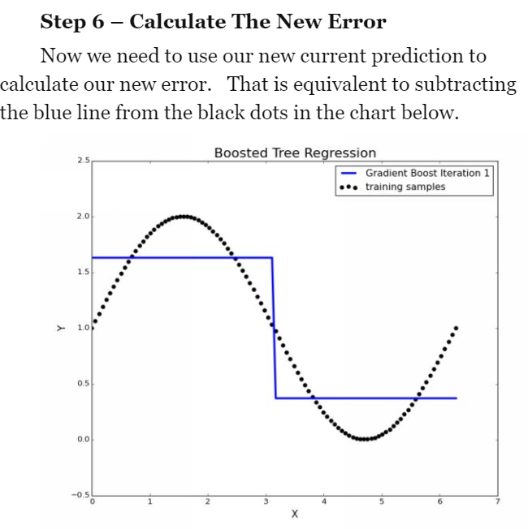
Gradient Boosted Trees

Slide 22

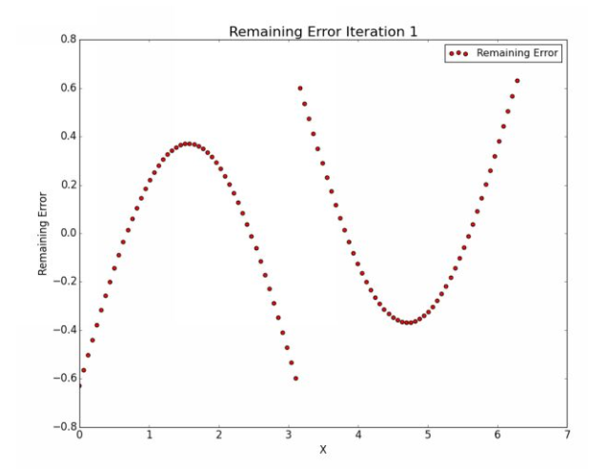
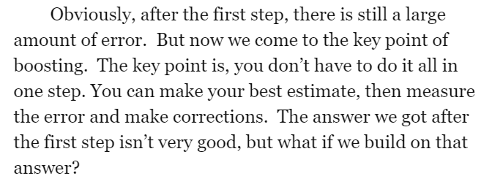
Gradient Boosted Trees

Slide 23
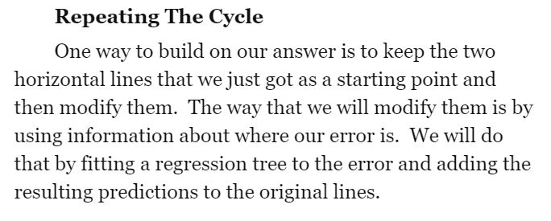
Gradient Boosted Trees

Slide 24
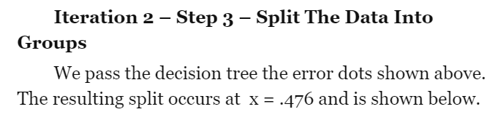
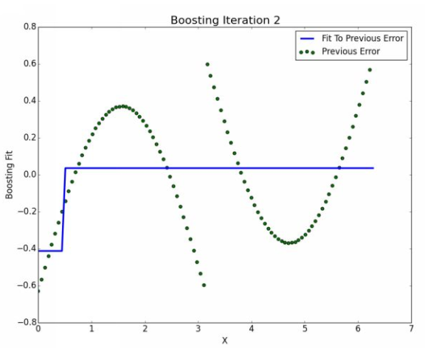
Gradient Boosted Trees

Slide 25
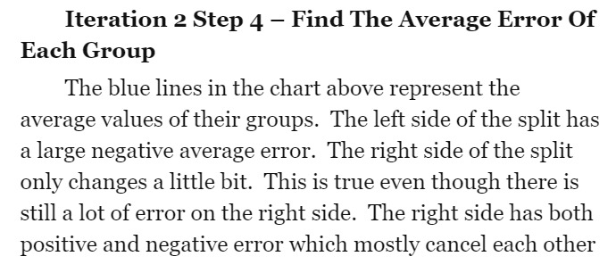
Gradient Boosted Trees

Slide 26
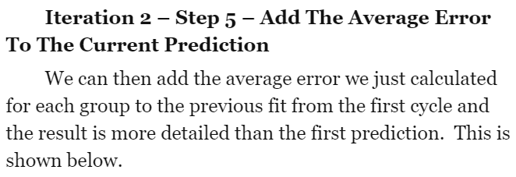
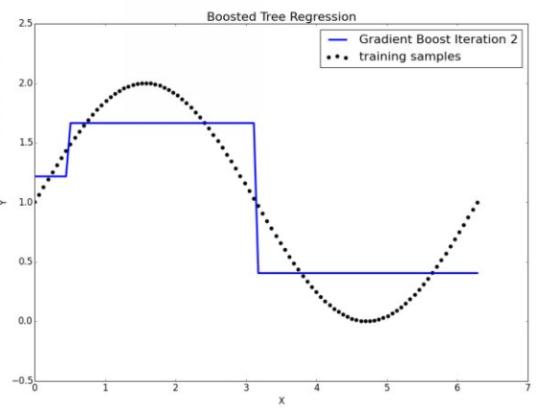
Gradient Boosted Trees

Slide 27
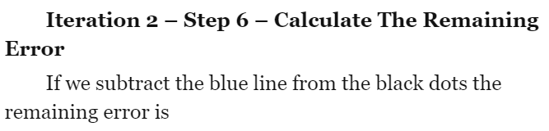
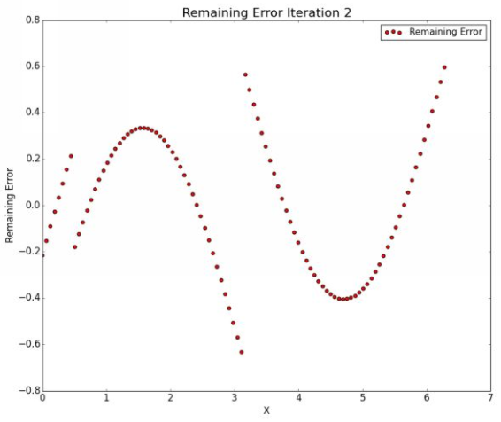
Gradient Boosted Trees

Slide 28
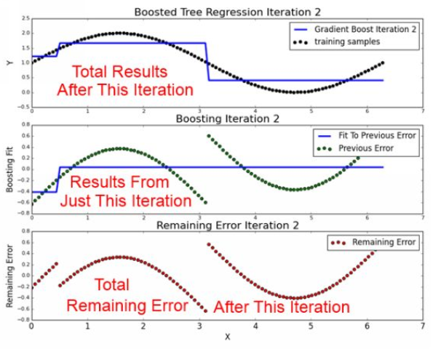
Gradient Boosted Trees

Slide 29

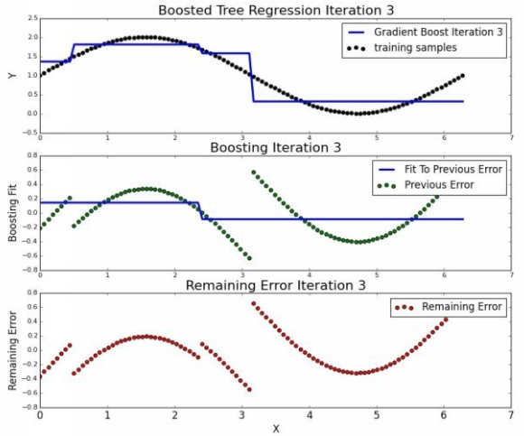
Gradient Boosted Trees

Slide 30
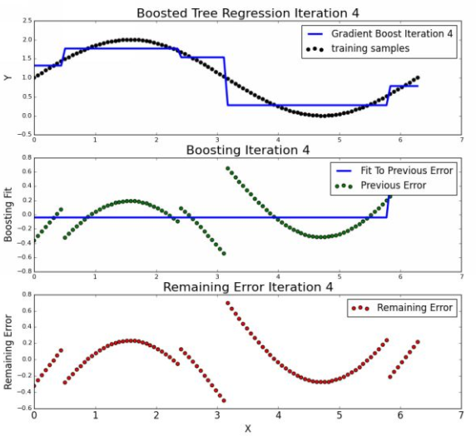
Gradient Boosted Trees

Slide 31
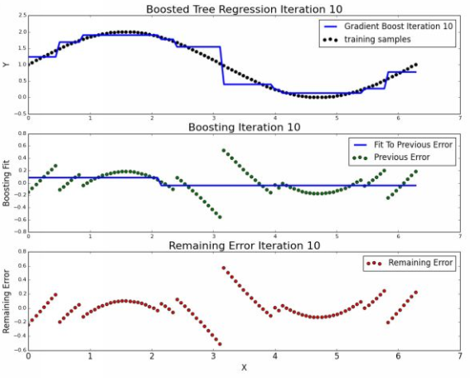
Gradient Boosted Trees

Slide 32
DEMO

Slide 33
Q&A

